Slide 1
The COE Academic Foundation
Fostering the innovators of the future

Slide 2
Academic Foundation Objectives
A 501c3 tax exempt organization dedicated to growing the trained resources to match industry workforce of the future needs
Fund the Dr. David M. Aber Scholarship Competition giving students the opportunity to showcase their work on projects involving the Dassault Systèmes solutions to leaders within the industry
Provide an attractive fertile digital engineering environment for student growth and eventual career opportunities
Create a vibrant COE led community of students, faculty and professionals that extend beyond the scheduled COE events
Strengthen the COE organization and participating companies by dedicating resources to meet the future workforce needs of all groups
Expand the DS footprint within universities and colleges to create discovery and brand recognition of DS engineering solutions
To join the Academic Program team or to learn more, please contact:
Nathan Shipley - nathan@niar.wichita.edu
Peter Finn – pfinn@coe.org

Slide 3
3 Year Rolling Plan (paused for COVID)
Year 1 - 2018
19 Student Volunteers on-site for the Academic Project Contest
- 10 Student Volunteers
- 40+ Students attended via sponsored bus
Full-day agenda and Parallel COE Track
- Networking
- Competition
$25K Budget*
Year 3 Target - 2024
(100) Students attending On-Site
- 25 Student Volunteers
- 75 Local one-day students
(10) International Poster Submissions
1 Day Tied to COE
- Plenary Sessions
- Networking
- Competition
- Interviews
- Student/Faculty Development Projects (Univ./Sponsors/COE/DS)
Ask the Experts Webinar Participation
$50K Budget*
Year 2 - 2019
(75) Students attending On-Site
- 25 Student Volunteers
- 50 Local one-day students
1 Day Tied to COE
- Plenary Session
- Networking
- Competition
Faculty Development Projects (Univ./Sponsors/COE/DS)
$35K Budget*

Slide 4
Academic Foundation Donor Levels
 | $15,000 Principal Corporate Academic Donor | $10,000 Major Corporate Academic Donor | $7,500 Supporting Corporate Academic Donor | $5,000 Sustaining Corporate Academic Donor
Corporate Membership (up to $7,500 value) | ü | ü | ü | û
Complimentary Registrations to COE Annual Conference for Human Resources representatives | 2 | 1 | û | û
5 Minute Corporate Presentation to students on "Why to work for my company" | ü | ü | ü | ü
Electronic copy of all student resumes | ü | ü | ü | ü
Access to private room for student interviews | ü | ü | û | û
Academic Sponsor Member recognition in NewsNet | "Principal" | "Major" | "Supporting" | "Sustaining"
Academic Sponsor Member recognition on COE website | "Principal" | "Major" | "Supporting" | "Sustaining"
Academic Sponsor Member recognition in General Session slides at COExperience Conference | "Principal" | "Major" | "Supporting" | "Sustaining"
Academic Sponsor Member Badge Ribbons at COE Annual Conference | "Principal" | "Major" | "Supporting" | "Sustaining"
Corporate Scholarship Sponsor Seating at Student Lunch | ü | ü | ü | ü
Recognition of sponsorship at podium during COExperience Conference | ü | û | û | û
Sponsored Article in selected issue of NewsNet | ü | û | û | û

Slide 5
Donor Benefits
Corporate Academic donors walked away with over 50 resumes from engineering student candidates in 2018; 75 in 2019
Unparalleled opportunities to network and engage interested students already producing projects using DS tools
Several students were interviewed and hired
Developing/cultivating the pipeline

Slide 6
Donor Benefits - Testimonial
“2019 was my first year attending COE, and it was an eye-opening experience. What caught my attention the most was the talented engineering students from many different universities. These students were highly motivated and skilled in Dassault’s products who not only excel in the classroom but are ambitious enough to volunteer, participate, and compete in the COE Academic Programs. Through the various interactions with the students as a representative from my company, I was able to recruit a couple of students who later became interns at my company. It was also a good forum to diversify and recruit students from US regions not a part of the corporate strategy. If recruiting and growing talents is a mission for your company, I think it would be a wise and valuable investment for any company with Dassault’s products to not only attend COE but also sponsor the COE Academic Program.” - Kevin Vu, IT PLM Manager at Textron Aviation

Slide 7
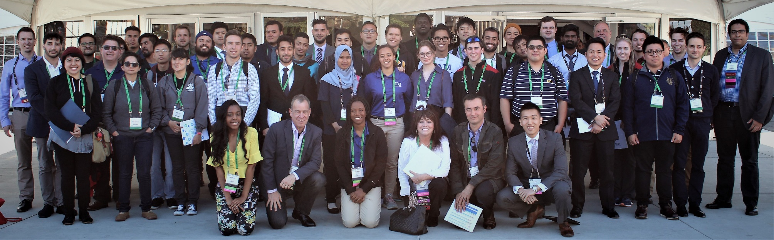
Achieve your dreams with the COE Scholarship Program
Attend COExperience 2024 May 13-16, Dallas, TX
Attend the Community of Experts COExperience Conference
Engage directly with industry leaders, top companies, and network with fellow students
See the “latest and greatest” engineering technology
Post your resume on our centralized database hub
Be at the forefront for networking:
Corporate Recruiting, internships, co-op opportunities, workforce placement.
Submit an academic project for our Dr. David M. Aber Scholarship Competition
First prize = $3000
Second prize = $1000
Dassault Systèmes certification exams available on-site!
COE Headquarters Contact: Conor Burton
coburton@coe.org

Slide 8
Student Reactions
How satisfied were you with the networking opportunities at COE?
Favorite part of the event:
“Getting to network with different companies.”
“The tent/booth portion because I got to talk to all sorts of different companies and people.”
“Professional Conference”
“Academic Project presentations”
“My favorite part of the event was the TechniFair”
“Student access to TechniFair”
“Meeting new people and learning more about the future of CATIA”
“I really enjoyed talking to all of the people from all of the companies.”

Slide 9
Student Motivations
Student Industry Interest
What was the most important factor in your decision to attend the COE conference?

